Slide 1




PHASE III
Final Model Selection
Architecture Overview & Selection Rationale
Three specialized deep learning models — each optimised for a distinct stage of the diagnostic pipeline.
01
02
03
CNN Binary Detection
MobileNetV2 Classification
U-Net Segmentation
Input: 128×128 Grayscale MRI
Input: 224×224 RGB MRI
Input: 128×128 MRI + Binary Mask
Conv2D × 2 + MaxPool + Dense layers
Pretrained MobileNetV2 + Dense 128
Encoder-Decoder + Skip Connections
Output: Healthy / Tumor (Sigmoid)
Output: 4-class Softmax (Glioma / Meningioma / Pituitary / None)
Output: Pixel-wise tumor mask (Sigmoid)
97% Test Accuracy
90% Test Accuracy
Dice Score 0.80+
✓ Selected — binary detection stage
✓ Selected — tumor type classification
✓ Selected — pixel-wise localisation

Slide 2
RESULTS
Performance Metrics
Extracted directly from model training and evaluation outputs
97.3%
90.0%
CNN BINARY DETECTION
Test Accuracy
97.3%
CNN Detection
Classification
Binary Classifier
MobileNetV2
Precision (Tumor)
97%
0.80+
99.6%
Recall (Tumor)
97%
Dice Score
Train Accuracy
F1-Score
0.97
U-Net Segmentation
CNN — Epoch 10
MOBILENETV2 CLASSIFICATION
Per-Class Metrics — MobileNetV2
Test Accuracy
90.0%
Class | Precision | Recall | F1
Glioma | 0.94 | 0.76 | 0.84
Meningioma | 0.85 | 0.86 | 0.86
Pituitary | 0.88 | 1.00 | 0.94
No Tumor | 0.94 | 0.98 | 0.96
Macro Avg F1
0.90
U-NET SEGMENTATION
Dice Coefficient
0.80+

Slide 3
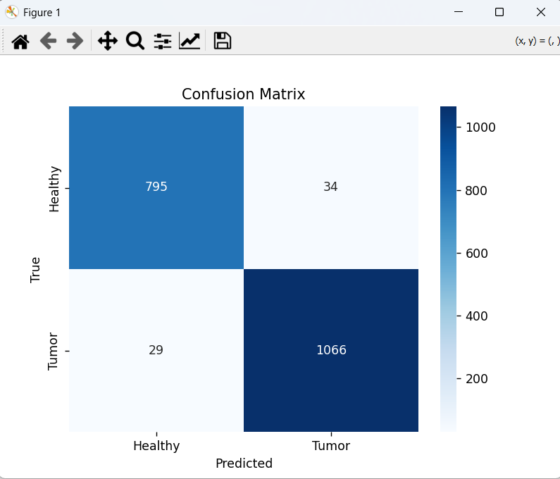
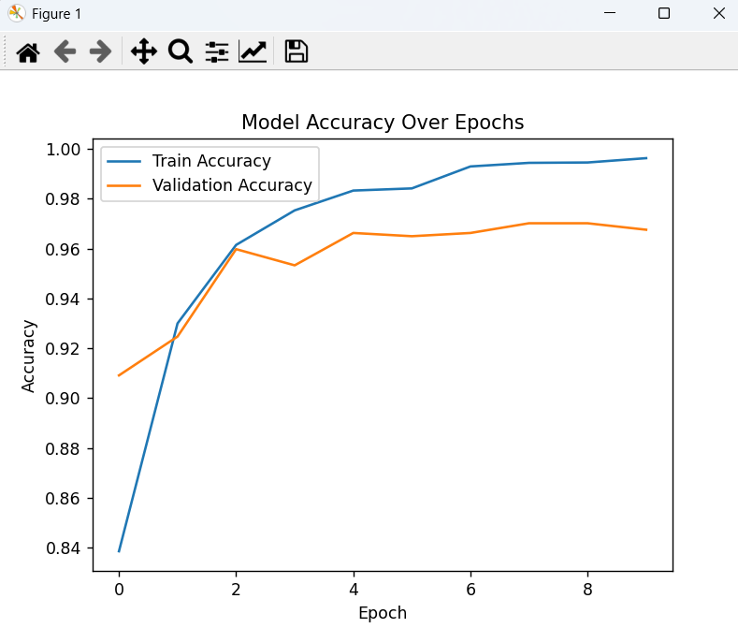
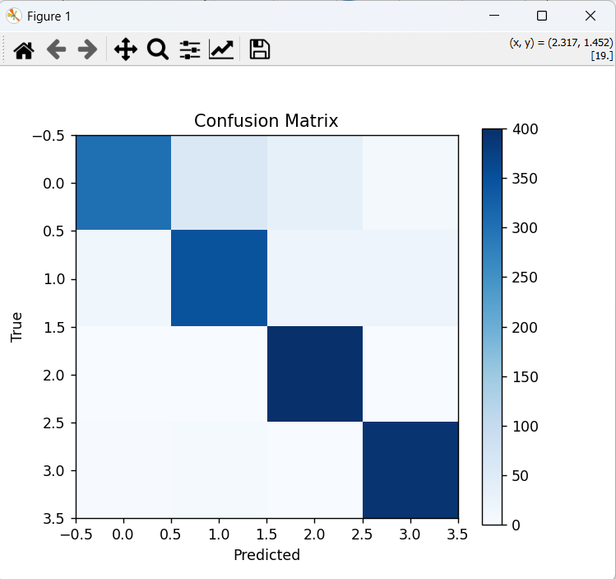
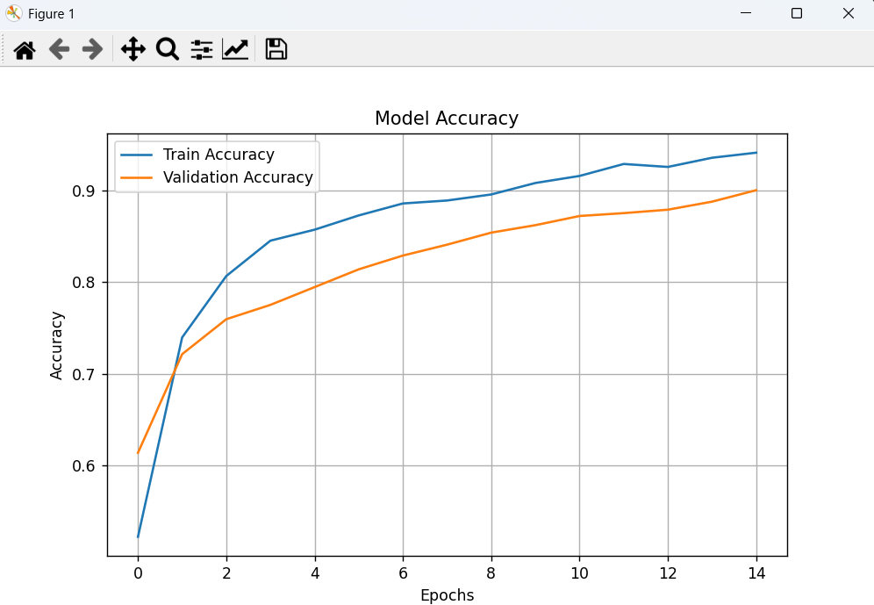
ACTUAL OUTPUTS
Results & Visualizations
Confusion matrices and training accuracy curves from model runs
CNN BINARY DETECTION
MOBILENETV2 CLASSIFICATION

Slide 4

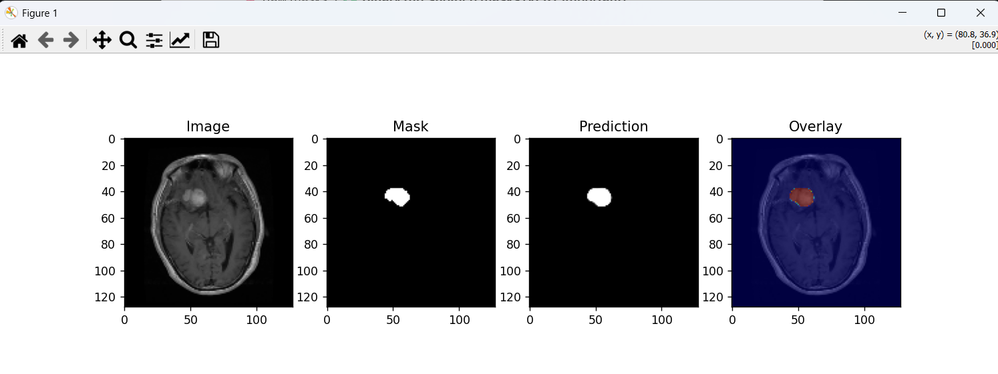
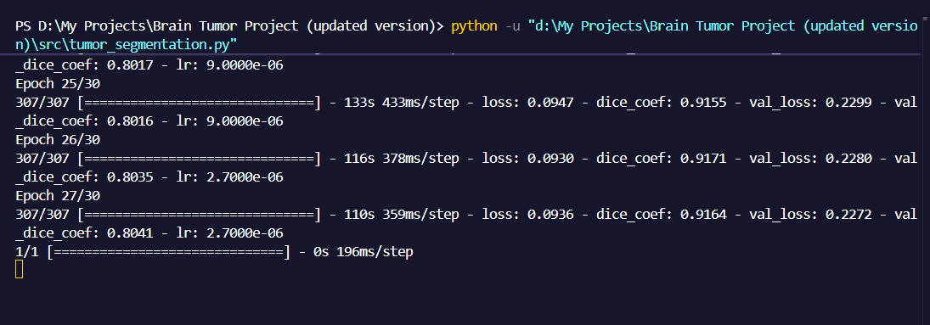
SEGMENTATION RESULTS
U-Net Tumor Segmentation Output
Pixel-wise prediction using Encoder-Decoder with Skip Connections — trained for 30 epochs
Original MRI
Ground Truth Mask
Predicted Mask
Tumor Overlay
Train Dice: 0.9164 Val Dice: 0.8041 Epochs: 30 (ReduceLROnPlateau + EarlyStopping)

Slide 5
BENCHMARKS
Comparative Analysis
Our proposed models vs existing baseline methods
Method | Accuracy | Architecture | Speed | Generalisation
Basic CNN (Baseline) | ~85% | Simple Conv | Fast | Limited
Our CNN Detection ✓ | 97.3% | Binary Classifier | Fast (10 ep) | High
ResNet50 (Literature) | ~91% | Deep ResNet | Slow | Good
VGG16 Transfer | ~88% | VGG16 TL | Moderate | Good
Our MobileNetV2 ✓ | 90.0% | MobileNetV2 TL | Efficient (15 ep) | High
Basic U-Net | Dice ~0.70 | Vanilla U-Net | Slow | Moderate
Our U-Net ✓ | Dice 0.80+ | BN + Dropout | Optimised (30 ep) | Strong
+12.3 pp
Eff. TL
Dice 0.80+
vs Baseline CNN
90% with MobileNetV2
↑ vs vanilla U-Net

Slide 6
REAL-WORLD IMPACT
Applications & Deployment
Real-world use cases and deployment possibilities
🏥
Hospital Diagnostic Support
🧠
MRI Analysis Automation
💊
Clinical Decision Assistance
AI-assisted MRI screening for accurate, faster tumor detection in clinical settings.
Automate manual radiologist review, significantly reducing analysis time.
Confidence scores and multi-class classifications to support oncologists.
📱
Remote Healthcare Access
🎓
Medical Education
🔬
AI-Assisted Radiology
Cloud deployment enables AI diagnostics in rural and underserved regions.
Training resource with annotated MRI examples for radiology students.
React + Streamlit dashboard for real-time MRI upload and reporting.
🚀 Future Deployment:
React + Streamlit web app • Mobile via QR code • Real-time GPU inference • Cloud integration (AWS / GCP)

Slide 7
KEY FINDINGS
Conclusion
All objectives achieved — end-to-end pipeline fully operational and validated
✅ 97.3% Detection Accuracy
✅ 90.0% Classification Accuracy
CNN Binary Classifier — real Kaggle MRI dataset (1,924 test samples)
MobileNetV2 — 4 classes: Glioma, Meningioma, Pituitary, No Tumor
✅ Dice Score 0.80+
✅ End-to-End Pipeline Operational
U-Net — Batch Norm + Dropout + combined Dice+BCE loss function
Input MRI → Detect → Classify → Segment → Annotated Report
✅ Real Datasets Validated
✅ Web App Prototype Built
Kaggle (detection + classification + segmentation)
React frontend + Streamlit backend — operational and demo-ready
This project demonstrates that deep learning pipelines are clinically feasible, accurate, and ready for real-world deployment in medical imaging.

Slide 8
FUTURE IMPROVEMENTS
Future Scope
Practical improvements planned for the next development cycle
🎨
Improved UI/UX
🌐
Official Website
Redesigned interface with intuitive user flows and visual feedback
Fully hosted platform with domain, SSL, and production backend
📱
Mobile Application
☁️
Cloud Deployment
Android and iOS apps for on-the-go MRI analysis
AWS / GCP hosting with auto-scaling and global accessibility
⚡
Faster GPU Inference
🔧
Model Optimisation
CUDA-accelerated prediction — target latency under 1 second
Pruning, quantisation, and distillation for lightweight models
📡
Real-Time Analysis
📊
More Training Data
Live MRI stream processing with instant detection and overlay
Larger, more diverse datasets for improved generalisation
📋
Enhanced Reports
🌏
Multi-Language Support
Automated clinical reports with size, location, and confidence scores
Localised interface supporting multiple languages for global use

Slide 9

CITATIONS
References
[1]
[5]
https://www.mayoclinic.org/diseases-conditions/brain-tumor/symptoms-causes/syc-20350084
Segmentation Dataset –
https://www.kaggle.com/datasets/nikhilroxtomar/brain-tumor-segmentation?utm_source=chatgpt.com
[2]
[6]
https://en.wikipedia.org/wiki/Brain_tumor
https://www.cancer.gov/types/brain/hp
[3]
[7]
https://my.clevelandclinic.org/health/diseases/6149-brain-cancer-brain-tumor
https://www.hopkinsmedicine.org/health/conditions-and-diseases/brain-tumor/brain-tumor-surgery
[4]
[8]
Tumor types Dataset -
https://www.kaggle.com/datasets/masoudnickparvar/brain-tumor-mri-dataset
https://www.cancerresearchuk.org/about-cancer/brain-tumours

Slide 10
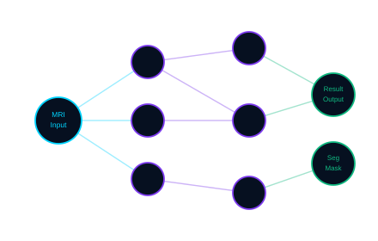
Thank You
Questions & Discussion
Brain Tumor Detection & Analysis Using Deep Learning
97.3% Detection 90.0% Classification 0.80+ Dice Score
Developed By
Aryan Sengar
Brain Tumor Detection & Analysis — Phase III | 2025–26
Technologies: Python • TensorFlow / Keras • OpenCV • Streamlit • React

